Slide 1

NAVIGATING THE FUTURE OF ONLINE SHOPPING
Summary of the project
By -: Swansik Tete

Slide 2
About Business
This business operates in the online shopping (e-commerce) sector, connecting customers with multiple sellers across different product categories. It manages orders, payments, and deliveries through a digital platform. The analysis helps understand overall business performance and identify areas for improvement.

Slide 3
Purpose of Analysis
The purpose of this analysis is to derive meaningful insights from sales data to understand category and seller performance, and evaluate the overall business performance for better decision-making.
To provide valuable insights into the business performance
To evaluate the performance of product categories and sellers
To understand the overall revenue contribution and trends of the company

Slide 4
Dataset Overview
Dataset Files:
CUSTOMERS.csv – Customer demographic details
SELLERS.csv – Seller information
ORDER_ITEMS.csv – Order item details
PAYMENTS.csv – Payment details
ORDERS.csv – Order history and details
PRODUCTS.csv – Product details

Slide 5
WORKFLOW AND TOOLS
SQL: - Import products.csv, orders.csv, customers.csv, and sellers.csv.
Python: - Use pandas to manipulate and visualize data.
Query Execution: - Run SQL queries using MySQL Workbench and Phyton for cross check.
Visualization: - Create graphs using Google Colab.
Tools :-
MySQL Workbench
Python Libraries: Pandas, Matplotlib

Slide 6


1.
Questions
Code
Code
Output
Output

Slide 7
BASIC PROBLEMS

Slide 8

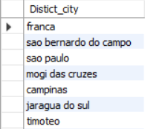
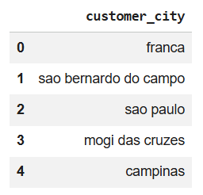
1. List all unique cities where customers are located.

Slide 9



2. Count the number of orders placed in 2017.

Slide 10
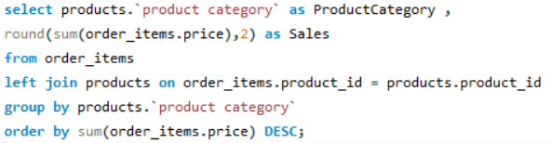
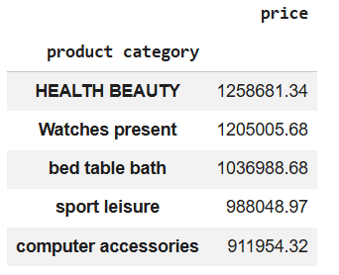
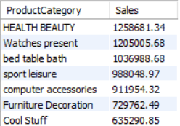
3. Find the total sales per category.

Slide 11
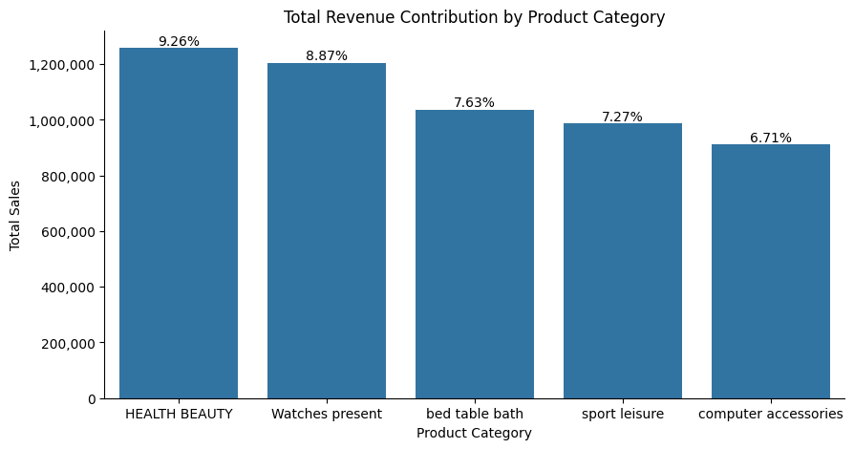
Total Revenue Contribution by product

Slide 12
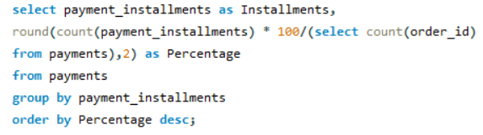

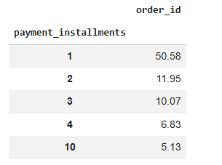
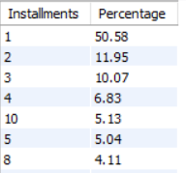
4. Calculate the percentage of orders that were paid in installments.

Slide 13
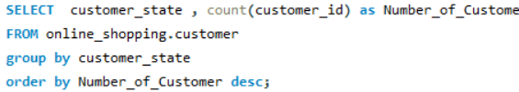
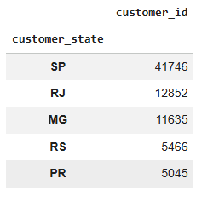
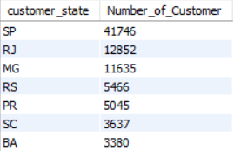
5. Count the number of customers from each state.

Slide 14
INTERMEDIATE PROBLEMS

Slide 15
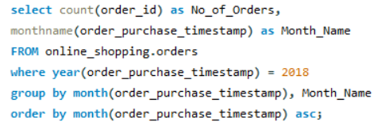
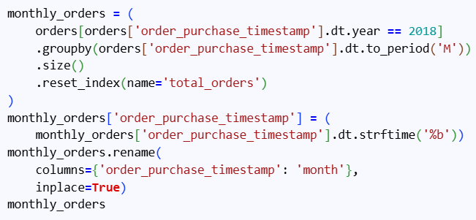
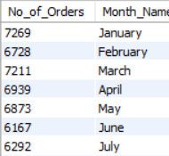
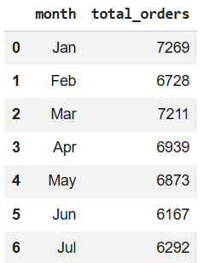
1. Calculate the number of orders per month in 2018.

Slide 16
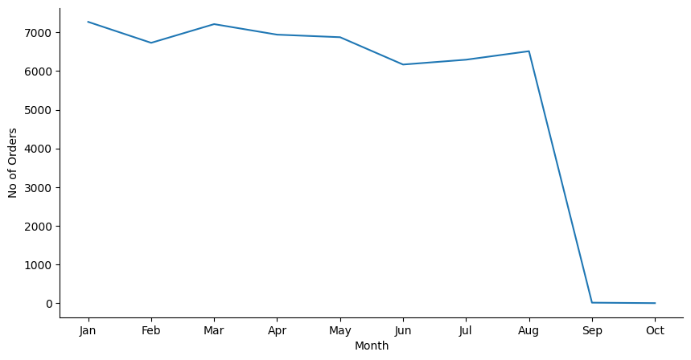
Orders Visualization for 2018.

Slide 17
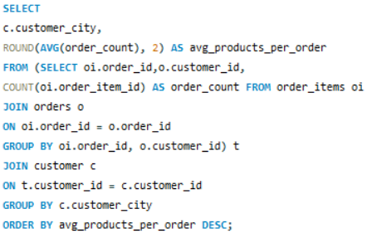
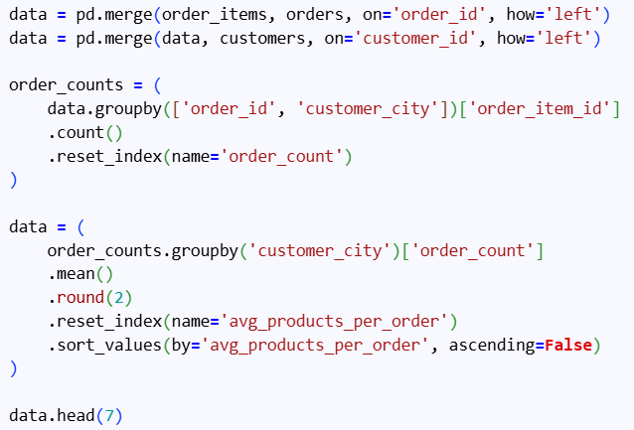
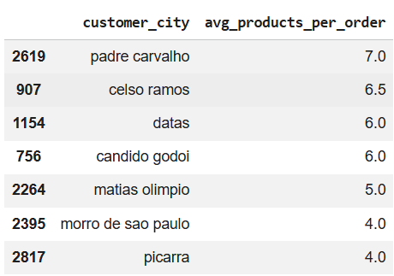
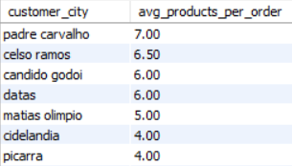
2. Find the average number of products per order grouped by customer city.

Slide 18
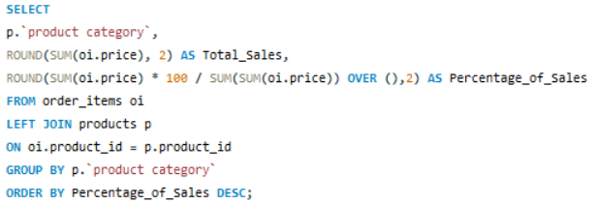
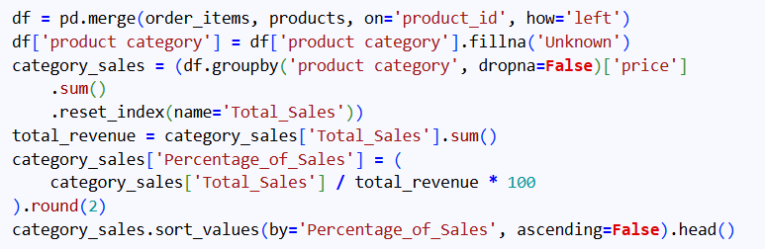
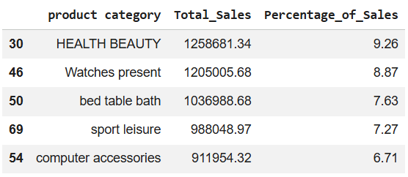
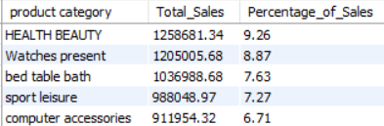
3. Calculate the percentage of total revenue contributed by each product category.

Slide 19
Total Revenue Contribution by product

Slide 20
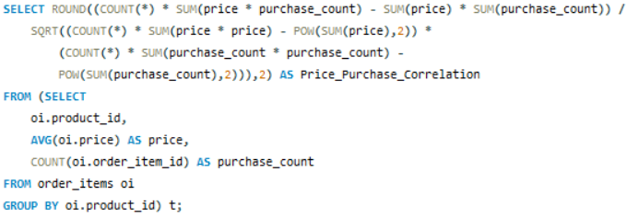
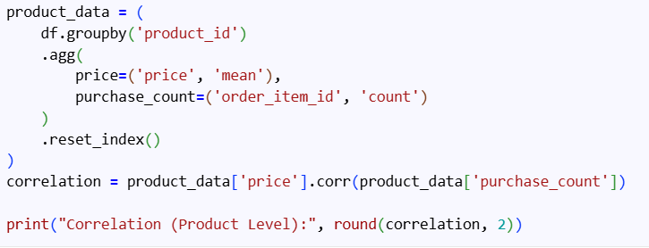

4. Identify the correlation between product price and the number of times a product has been purchased.

Slide 21
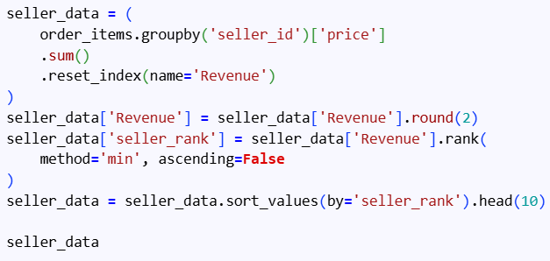
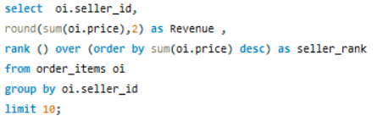
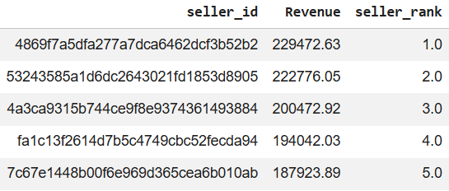
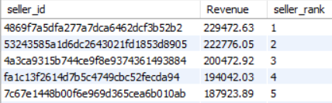
5. Calculate the total revenue generated by each seller and rank them by revenue.

Slide 22
ADVANCED PROBLEMS

Slide 23
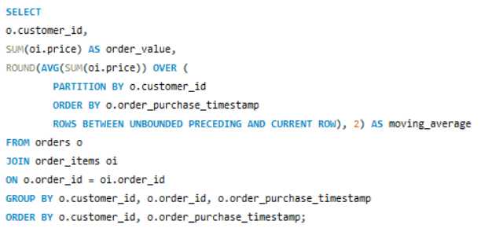
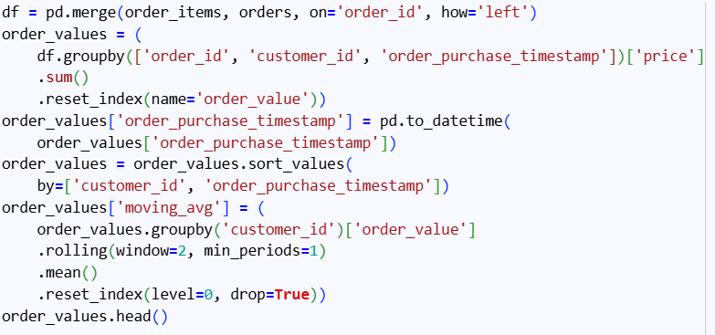
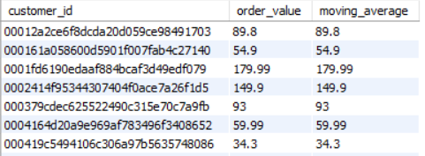
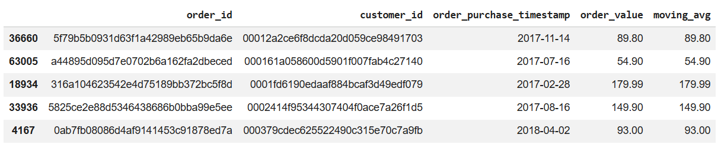
1. Calculate the moving average of order values for each customer over their order history.

Slide 24
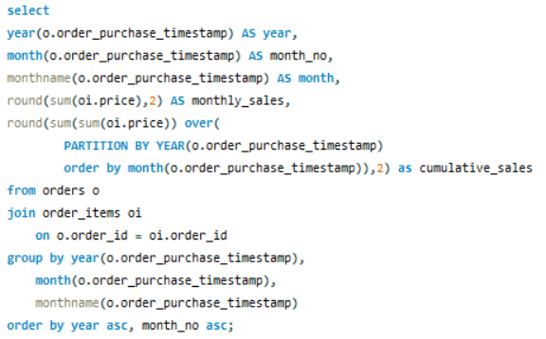
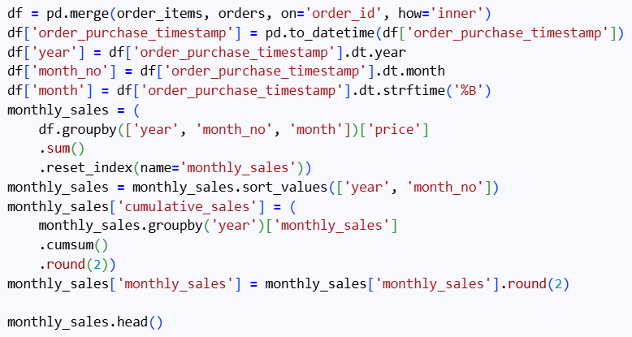
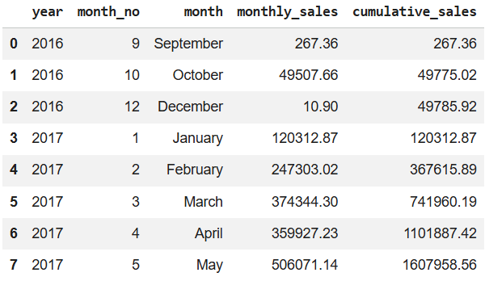
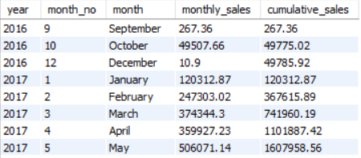
2. Calculate the cumulative sales per month for each year.

Slide 25
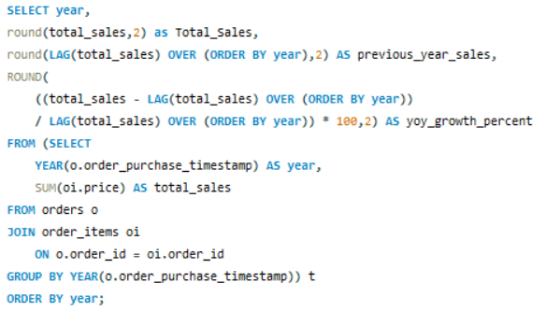
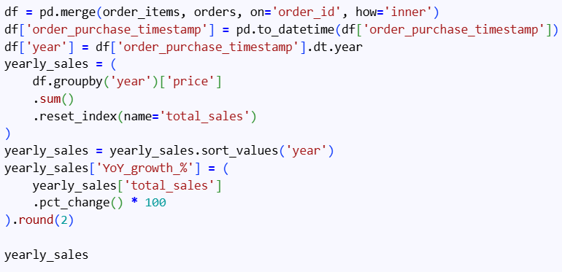
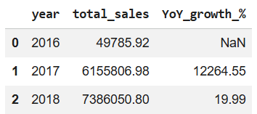

3. Calculate the year‑over‑year growth rate of total sales.

Slide 26
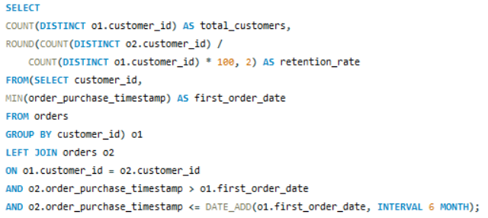
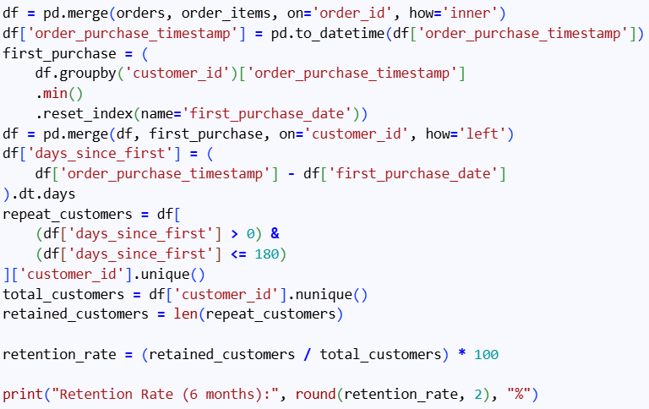

4. Calculate the retention rate of customers (customers who make another purchase within 6 months of their first purchase).

Slide 27
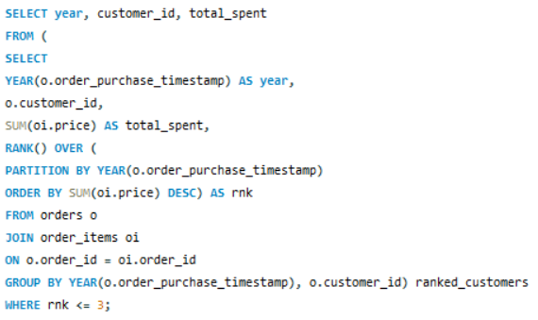
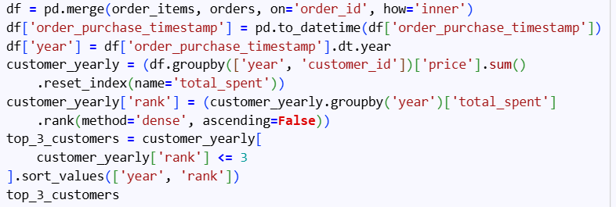
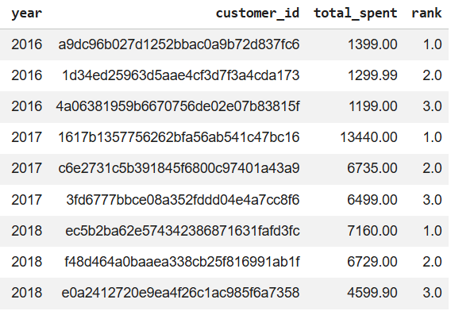
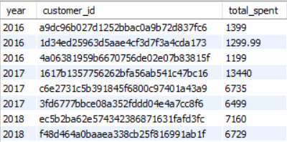
5. Identify the top 3 customers who spent the most money in each year.

Slide 28
Thank You
Email: teteswansik@mail.com
GitHub: https://github.com/Swansik-Tete
LinkedIn: www.linkedin.com/in/swansik-tete-9628362a1
By Swansik Tete

